Slide 1

MSc Projects

Slide 2
Overview
Reinforcement learning
Muti-threshold agent Intro
Trending Trading Agents
methodology
Project Objectives
Results

Slide 3
Reinforcement learning
Reinforcement learning (RL) is a branch of machine learning that focuses on training agents to make sequential decisions in an environment to maximize a long-term cumulative reward. In RL, an agent learns through trial and error by interacting with the environment.
RL algorithms, such as Q-learning, Deep Q-Networks (DQN), and Proximal Policy Optimization (PPO), are employed to train agents. These algorithms update the agent's policy or value function based on the observed rewards and the agent's interactions with the environment.
RL has found applications in various domains, including robotics, gaming, finance, and healthcare. It has the potential to solve complex decision-making problems and learn optimal strategies in dynamic environments where explicit supervision or labeled data is limited.

Slide 4
Trading Trending Agents
Trading trending agents are strategies designed to identify and profit from trends in financial markets. The objective is to find strategies that perform well during trending periods, as current RL agents tend to excel in consolidation periods. To meet this objective, it is preferred to apply strategies using the DC sampled data.
By exploring and developing effective strategies for trading in trending periods, the aim is to enhance the performance and profitability of trading agents and contribute to the academic understanding of trend-following approaches in financial markets.

Slide 5
Multi-Threshold Agents
The multi threshold agent model focuses on utilizing multiple thresholds in analyzing tick data for trading purposes. Tick data refers to the individual trades or price changes that occur in financial markets. When different thresholds are applied to the same set of tick data, larger thresholds may provide different results compared to smaller thresholds. However, when these thresholds align, there may be opportunities for profitable trades.
The aim of your research is to develop a reinforcement learning (RL) based system that can incorporate information from multiple thresholds at a single point in time. This information acts as a representation of the state and can be used to train an RL agent with a suitable reward function. The goal is to train this agent to make profitable trading decisions based on the alignment of multiple thresholds.If successful this will likely be the route of an academic paper.

Slide 6
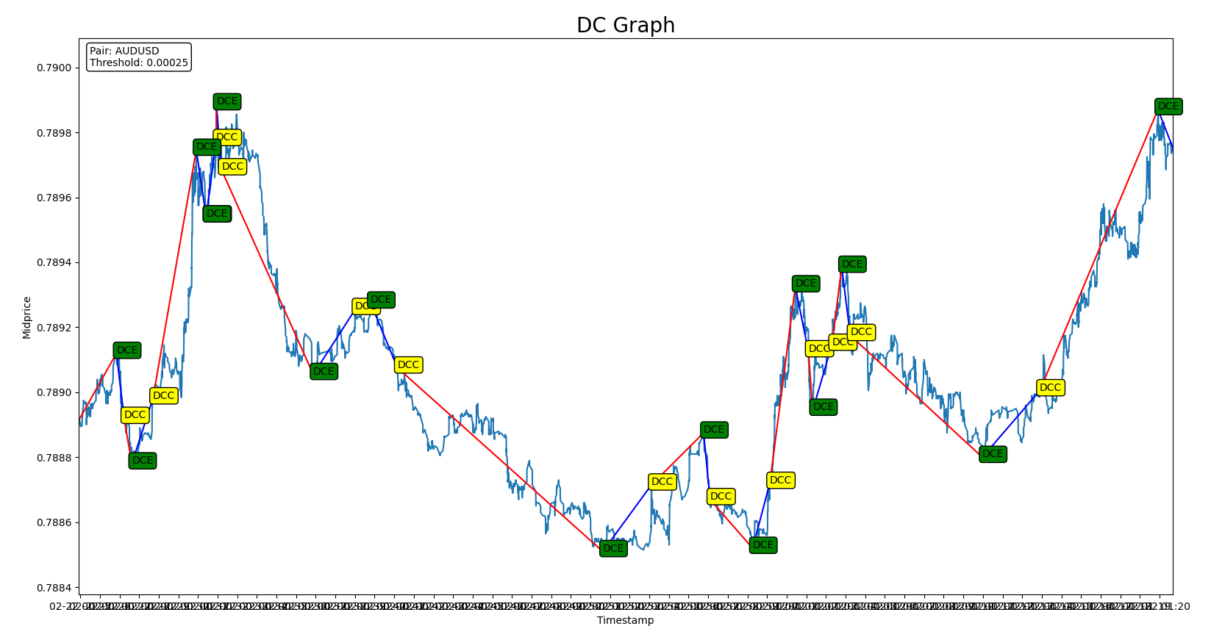

Slide 7
Project Objectives
Create an environment that allows the state to be represented (I have most of the code to do this).
Design a reward function that can coax the agent into learning a profitable strategy.
Compare this strategy to benchmarks.
Create
Design
Compare

Slide 8
---------------------------------
| rollout/ | |
| ep_len_mean | 995 |
| ep_rew_mean | -3.75 |
| time/ | |
| fps | 233 |
| iterations | 1 |
| time_elapsed | 8 |
| total_timesteps | 2048 |
---------------------------------
-----------------------------------------
| rollout/ | |
| ep_len_mean | 995 |
| ep_rew_mean | -3.4 |
| time/ | |
| fps | 238 |
| iterations | 3 |
| time_elapsed | 25 |
| total_timesteps | 6144 |
| train/ | |
| approx_kl | 0.006733703 |
| clip_fraction | 0.00601 |
| clip_range | 0.2 |
| entropy_loss | -0.653 |
| explained_variance | 0.0803 |
| learning_rate | 0.0003 |
| loss | -0.0195 |
| n_updates | 20 |
| policy_gradient_loss | -0.00168 |
| value_loss | 0.0026 |
-----------------------------------------

